Slide 1
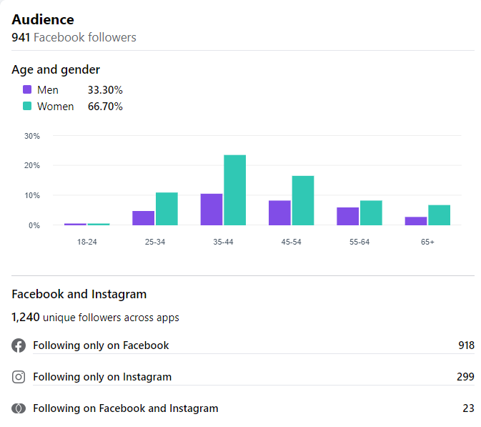
Facebook Insights December 2022

Slide 2
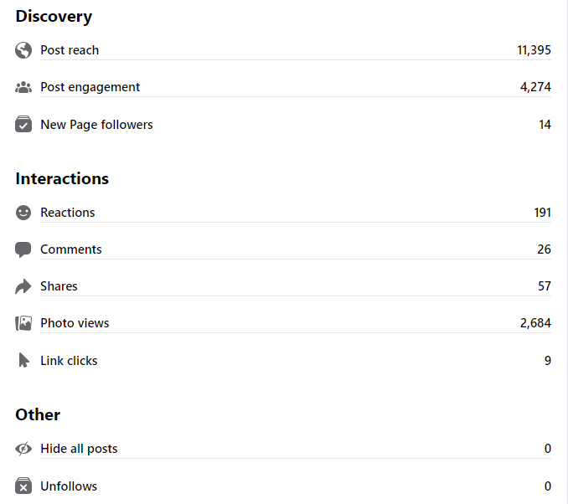
Page
Overview

Slide 3
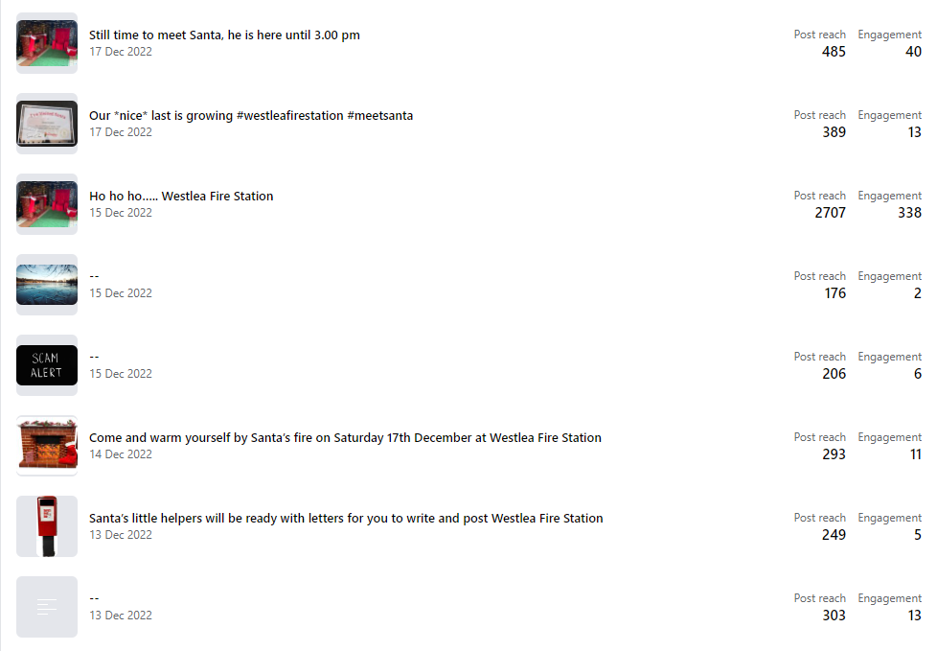
Post Insights
Post Reach
The number of people who saw any of your posts at least once.
Post Engagement
The number of times that people engaged with your post through reactions, comments, shares, views and clicks

